Slide 1
ACHIEVING OPERATIONAL EXCELLENCE AND CUSTOMER INTIMACY: ENTERPRISE APPLICATIONS
Chapter 9 (Laudon & Laudon)
1. Sistemas de Informação II
VIDEO CASES
Case 1: Sinosteel Strengthens Business Management with ERP Applications
Case 2: Ingram Micro and H&R Block Get Close to Their Customers
Instructional Video 1: Zara's" Wearing Today's Fashions With Supply Chain Management

Slide 2
CHAPTER 9: ACHIEVING OPERATIONAL EXCELLENCE AND
CUSTOMER INTIMACY: ENTERPRISE APPLICATIONS
Learning Objectives
How do enterprise systems help businesses achieve operational excellence?
How do supply chain management systems coordinate planning, production, and logistics with suppliers?
How do customer relationship management systems help firms achieve customer intimacy?
What are the challenges posed by enterprise applications?
How are enterprise applications used in platforms for new cross-functional services?
© Prentice Hall 2011
Notes:
This chapter looks at enterprise systems, which collect and integrate data from many different departments and systems throughout the business. Ask students to review what operational excellence is. What is customer intimacy and why does this help the business? Ask them to talk about some firms they have dealt with and which they thought demonstrated operational excellence. Why was it “excellent.” Ask students to talk about firms where operations were really not good at all. Why not?

Slide 3
CHAPTER 9: ACHIEVING OPERATIONAL EXCELLENCE AND
CUSTOMER INTIMACY: ENTERPRISE APPLICATIONS
Enterprise Systems
Enterprise Systems
  Also called “enterprise resource planning (ERP) systems”
  Suite of integrated software modules and a common central database
  Collects data from many divisions of firm for use in nearly all of firm’s internal business activities
  Information entered in one process is immediately available for other processes
© Prentice Hall 2011
Notes:
This slide describes the main purpose of enterprise systems. Ask students for examples of why it might be valuable to have information from one process instantly available to another process.

Slide 4
CHAPTER 9: ACHIEVING OPERATIONAL EXCELLENCE AND
CUSTOMER INTIMACY: ENTERPRISE APPLICATIONS
Enterprise Systems
Enterprise Software
  Built around thousands of predefined business processes that reflect best practices
    Finance/accounting: General ledger, accounts payable, etc.
    Human resources: Personnel administration, payroll, etc.
    Manufacturing/production: Purchasing, shipping, etc.
    Sales/marketing: Order processing, billing, sales planning, etc.
  To implement, firms:
    Select functions of system they wish to use
    Map business processes to software processes
      Use software’s configuration tables for customizing
© Prentice Hall 2011
Notes:
This slide describes the functions in an enterprise software package and how it would be implemented by a firm. Ask students why it is typically best to perform only minimal changes to enterprise software, and instead, change the way the firm works in order to conform to the software’s business processes.

Slide 5
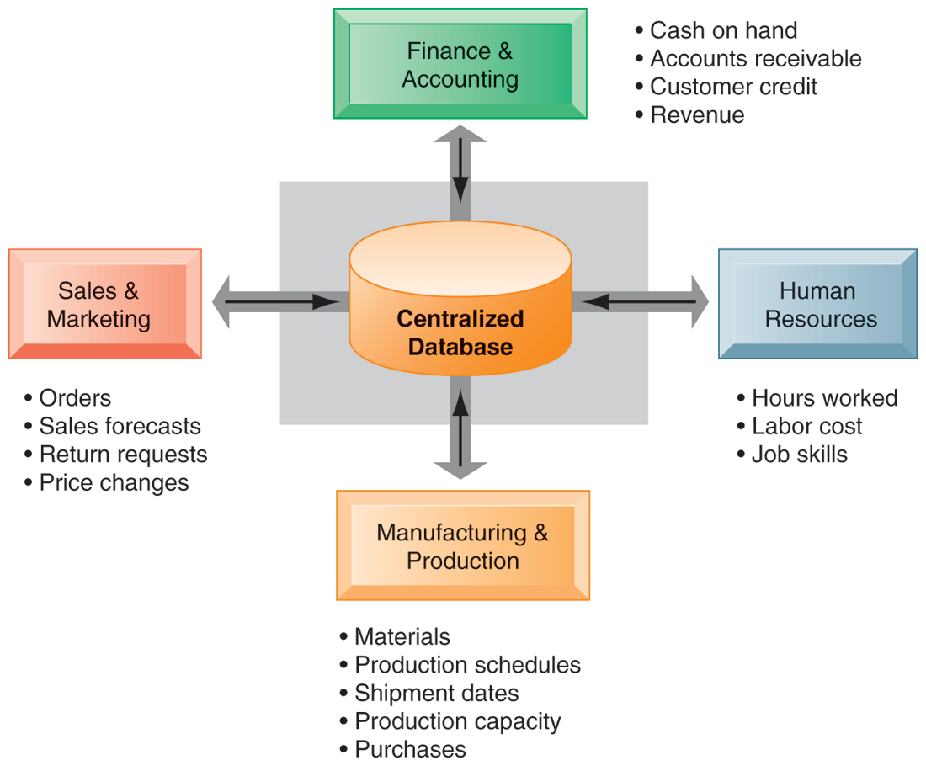
CHAPTER 9: ACHIEVING OPERATIONAL EXCELLENCE AND
CUSTOMER INTIMACY: ENTERPRISE APPLICATIONS
Enterprise Systems
HOW ENTERPRISE SYSTEMS WORK
Enterprise systems feature a set of integrated software modules and a central database that enables data to be shared by many different business processes and functional areas throughout the enterprise.
FIGURE 9-1
© Prentice Hall 2011
Notes:
This graphic illustrates the function of enterprise software to integrate and share data between the different business functions. One of the key ideas of enterprise solutions is that there’s “one company, one database” and not a collection of disconnected databases.

Slide 6
CHAPTER 9: ACHIEVING OPERATIONAL EXCELLENCE AND
CUSTOMER INTIMACY: ENTERPRISE APPLICATIONS
Enterprise Systems
Business value of enterprise systems
  Increase operational efficiency
  Provide firm wide information to support decision making
  Enable rapid responses to customer requests for information or products
  Include analytical tools to evaluate overall organizational performance
© Prentice Hall 2011
Notes:
This slide discusses the business values of enterprise systems. What does it mean for the firm that enterprise systems enforce the use of common standardized definitions and formats for data by the entire organization? The text discusses Coca Cola, which implemented an SAP enterprise system to standardize and coordinate important business processes in 200 countries. Lack of standardized business processes prevented the company from leveraging its worldwide buying power to obtain lower prices for raw materials and from reacting rapidly to market changes.

Slide 7
CHAPTER 9: ACHIEVING OPERATIONAL EXCELLENCE AND
CUSTOMER INTIMACY: ENTERPRISE APPLICATIONS
Supply Chain Management Systems
Supply chain:
  Network of organizations and processes for:
    Procuring raw materials
    Transforming them into products
    Distributing the products
Upstream supply chain:
  Firm’s suppliers, suppliers’ suppliers, processes for managing relationships with them
Downstream supply chain:
  Organizations and processes responsible for delivering products to customers
© Prentice Hall 2011
Notes:
This slide introduces the concept of the supply chain. Supply chain management software is a type of enterprise software for managing complicated supply chains that may include thousands of suppliers. The text gives the example of Nike’s sneakers’ supply chain. What types of firms are in the upstream supply chain? In the downstream supply chain?

Slide 8
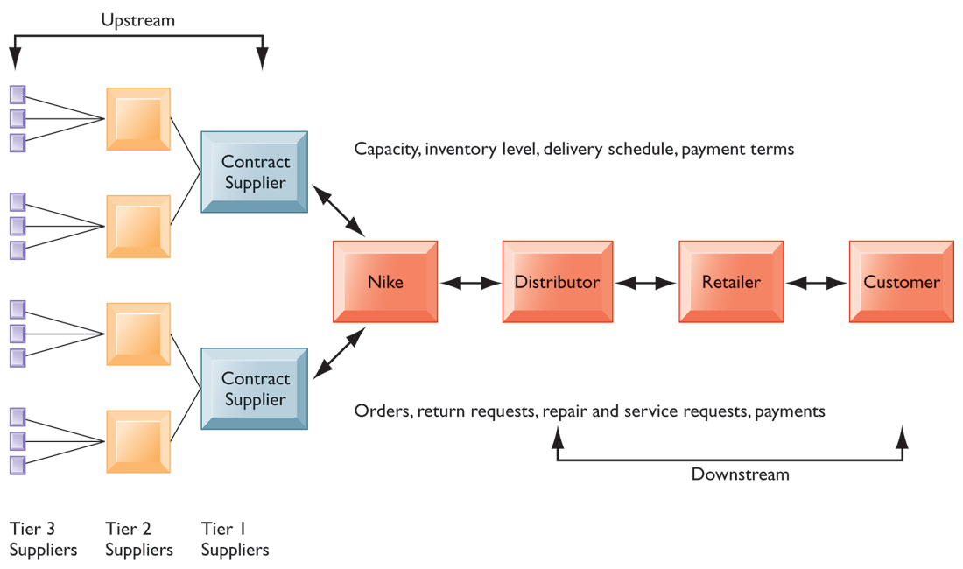
CHAPTER 9: ACHIEVING OPERATIONAL EXCELLENCE AND
CUSTOMER INTIMACY: ENTERPRISE APPLICATIONS
Supply Chain Management Systems
NIKE’S SUPPLY CHAIN
FIGURE 9-2
This figure illustrates the major entities in Nike’s supply chain and the flow of information upstream and downstream to coordinate the activities involved in buying, making, and moving a product. Shown here is a simplified supply chain, with the upstream portion focusing only on the suppliers for sneakers and sneaker soles.
© Prentice Hall 2011
Notes:
This graphic illustrates the major entities in Nike’s supply chain. Ask students what the difference is between tier 1, 2, and 3 suppliers.

Slide 9
CHAPTER 9: ACHIEVING OPERATIONAL EXCELLENCE AND
CUSTOMER INTIMACY: ENTERPRISE APPLICATIONS
Supply Chain Management Systems
Information and supply chain management
  Inefficiencies cut into a company’s operating costs
    Can waste up to 25% of operating expenses
  Just-in-time strategy:
    Components arrive as they are needed
    Finished goods shipped after leaving assembly line
  Safety stock
    Buffer for lack of flexibility in supply chain
  Bullwhip effect
    Information about product demand gets distorted as it passes from one entity to next across supply chain
© Prentice Hall 2011
Notes:
This slide discusses the effects of timely and untimely information on a supply chain. Ask students what causes inefficiencies in a supply chain (parts shortages, underutilized plant capacity, excessive finished goods inventory, high transportation costs). These are caused by untimely information. Perfect information– or nearly perfect-- can result in a just-in-time strategy where inventories and buffers are reduced to nearly zero. But because of the lack of timely information, manufacturers keep safety stock of parts and inventory. Why is this an inefficient result? Another effect of uncertainties is the bullwhip effect. How can information slow or eliminate bullwhip effects?

Slide 10
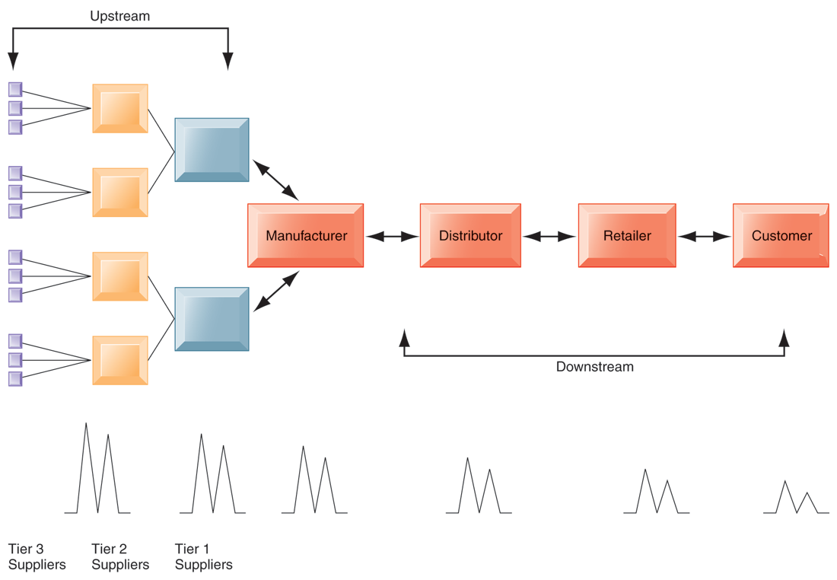
CHAPTER 9: ACHIEVING OPERATIONAL EXCELLENCE AND
CUSTOMER INTIMACY: ENTERPRISE APPLICATIONS
Supply Chain Management Systems
THE BULLWHIP EFFECT
FIGURE 9-3
Inaccurate information can cause minor fluctuations in demand for a product to be amplified as one moves further back in the supply chain. Minor fluctuations in retail sales for a product can create excess inventory for distributors, manufacturers, and suppliers.
© Prentice Hall 2011
Notes:
This graphic illustrates how a slight rise in demand by customers for an item will cause successive participants to slightly overstock related inventory “just in case”. These changes are amplified as one moves back further in the system.

Slide 11
CHAPTER 9: ACHIEVING OPERATIONAL EXCELLENCE AND
CUSTOMER INTIMACY: ENTERPRISE APPLICATIONS
Supply Chain Management Systems
Supply chain management software
  Supply chain planning systems
    Model existing supply chain
    Demand planning
    Optimize sourcing, manufacturing plans
    Establish inventory levels
    Identifying transportation modes
  Supply chain execution systems
    Manage flow of products through distribution centers and warehouses
© Prentice Hall 2011
Notes:
This slide describes some of the activities involved in building a supply chain management system. Building one of these systems encourages managers to take a deep and detailed look at how their business operates.

Slide 12
CHAPTER 9: ACHIEVING OPERATIONAL EXCELLENCE AND
CUSTOMER INTIMACY: ENTERPRISE APPLICATIONS
Supply Chain Management Systems
SOUTHWEST AIRLINES TAKES OFF WITH BETTER SUPPLY CHAIN MANAGEMENT
Why is parts inventory management so important at Southwest Airlines? What business processes are affected by the airlines’ ability or inability to have required parts on hand?
Why management, organization, and technology factors were responsible for Southwest’s problems with inventory management?
How did implementing the i2 software change the way Southwest ran its business?
Describe two decisions that were improved by implementing the i2 system?
© Prentice Hall 2011
Notes:
This slide discusses the case study on Southwest Airlines, whose legacy systems were unable to keep up with their continued expansion and provide information to other systems. Information about replacement parts was difficult to find, slowing response times.

Slide 13
CHAPTER 9: ACHIEVING OPERATIONAL EXCELLENCE AND
CUSTOMER INTIMACY: ENTERPRISE APPLICATIONS
Supply Chain Management Systems
Global supply chain issues
  Global supply chains typically span greater geographic distances and time differences
  More complex pricing issues (local taxes, transportation, etc.)
  Foreign government regulations
Internet helps companies manage many aspects of global supply chains
  Sourcing, transportation, communications, international finance
© Prentice Hall 2011
Notes:
This slide discusses the additional complexities experienced by global supply chains. The text cites the example of Koret of California, which uses e-SPS Web-based software to gain end-to-end visibility into its entire global supply chain. Today’s apparel industry relies heavily on outsourcing to contract manufacturers in China and other low-wage countries. Apparel companies are starting to use the Web to manage their global supply chain and production issues.

Slide 14
CHAPTER 9: ACHIEVING OPERATIONAL EXCELLENCE AND
CUSTOMER INTIMACY: ENTERPRISE APPLICATIONS
Supply Chain Management Systems
Supply chain management systems
  Push-based model (build-to-stock)
    Schedules based on best guesses of demand
  Pull-based model (demand-driven)
    Customer orders trigger events in supply chain
  Sequential supply chains
    Information and materials flow sequentially from company to company
  Concurrent supply chains
    Information flows in many directions simultaneously among members of a supply chain network
© Prentice Hall 2011
Notes:
This slide discusses the fact that SCM systems facilitate efficient customer response, allowing the workings of the business to be driven more by customer demand, moving from push-based, sequential models to pull-based, concurrent models. Ask students for examples from the text of the pull-based model (Walmart, Dell.)

Slide 15
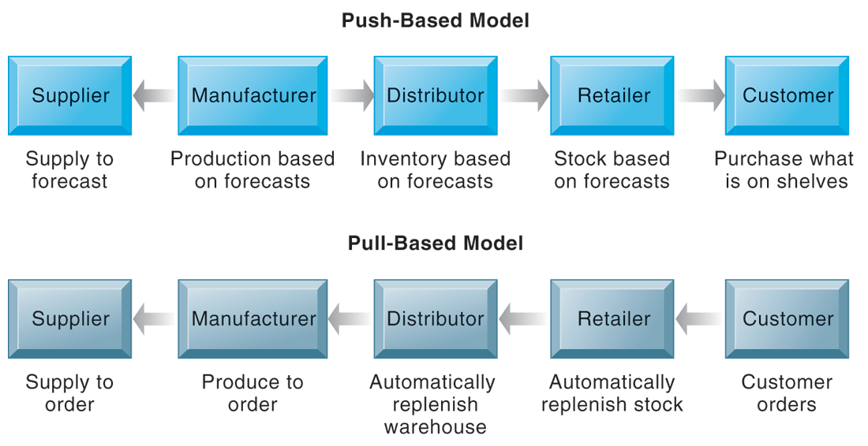
CHAPTER 9: ACHIEVING OPERATIONAL EXCELLENCE AND
CUSTOMER INTIMACY: ENTERPRISE APPLICATIONS
Supply Chain Management Systems
THE BULLWHIP EFFECT
FIGURE 9-4
The difference between push- and pull-based models is summarized by the slogan, “Make what we sell, not sell what we make.”
© Prentice Hall 2011
Notes:
This graphic illustrates the difference between the earlier, push-based model of supply chains to the pull-based model. Ask students if there are some industries uniquely suited to the pull-based model. How about automobiles, appliances and consumer durables? What are the draw backs of a pull-based model?

Slide 16
CHAPTER 9: ACHIEVING OPERATIONAL EXCELLENCE AND
CUSTOMER INTIMACY: ENTERPRISE APPLICATIONS
Supply Chain Management Systems
Business value of SCM systems
  Match supply to demand
  Reduce inventory levels
  Improve delivery service
  Speed product time to market
  Use assets more effectively
  Reduced supply chain costs lead to increased profitability
  Increased sales
© Prentice Hall 2011
Notes:
This slide examines the value of using SCM systems to businesses. Ask students how increases in sales can result from a more efficient supply chain.

Slide 17
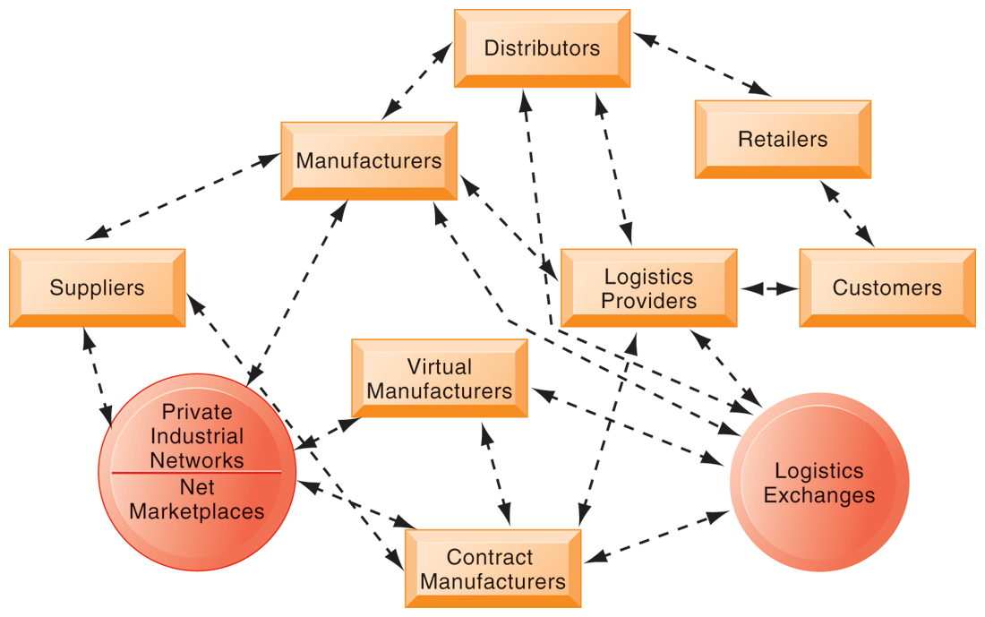
CHAPTER 9: ACHIEVING OPERATIONAL EXCELLENCE AND
CUSTOMER INTIMACY: ENTERPRISE APPLICATIONS
Supply Chain Management Systems
THE FUTURE INTERNET-DRIVEN SUPPLY CHAIN
The future Internet-driven supply chain operates like a digital logistics nervous system. It provides multidirectional communication among firms, networks of firms, and e-marketplaces so that entire networks of supply chain partners can immediately adjust inventories, orders, and capacities.
FIGURE 9-5
© Prentice Hall 2011
Notes:
This graphic illustrates the multidirectional communications within a future supply chain driven by the Internet. Private industrial networks and net marketplaces are discussed in Chapter 10 (E-commerce). Private industrial networks are typically a large firm using an extranet to link to its suppliers and other key business partners. Net marketplaces are digital marketplaces based on Internet technology for many different buyers and sellers.

Slide 18
CHAPTER 9: ACHIEVING OPERATIONAL EXCELLENCE AND
CUSTOMER INTIMACY: ENTERPRISE APPLICATIONS
Customer Relationship Management Systems
Knowing the customer
  In large businesses, too many customers and too many ways customers interact with firm
Customer relationship management (CRM) systems
  Capture and integrate customer data from all over the organization
  Consolidate and analyze customer data
  Distribute customer information to various systems and customer touch points across enterprise
  Provide single enterprise view of customers
© Prentice Hall 2011
Notes:
This slide introduces the concept of customer relationship management as a key function of the business and the use of CRM systems to provide a single place to consolidate and analyze data about the customer. Ask students to provide examples of the different types of customer data that would be captured by a firm. What is a touch point (ask students to give examples of touch points)? What types of valuable information does the firm need to know about its customers (most profitable, loyal customers)? Have students directly interacted with a CRM? They probably do not know it, but anytime they call into a call center for help they are dealing with some kind of CRM that tracks some or all of their interactions with a firm.

Slide 19
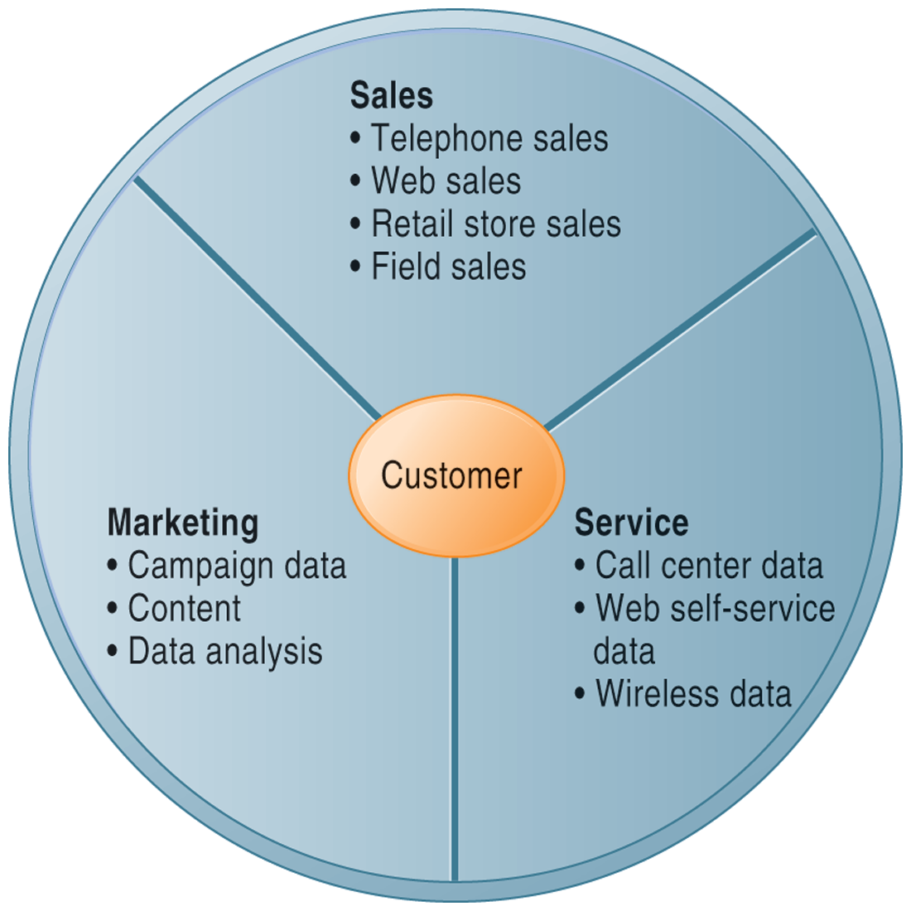
CHAPTER 9: ACHIEVING OPERATIONAL EXCELLENCE AND
CUSTOMER INTIMACY: ENTERPRISE APPLICATIONS
Customer Relationship Management Systems
CUSTOMER RELATIONSHIP MANAGEMENT (CRM)
CRM systems examine customers from a multifaceted perspective. These systems use a set of integrated applications to address all aspects of the customer relationship, including customer service, sales, and marketing.
FIGURE 9-6
© Prentice Hall 2011
Notes:
This graphic illustrates the functions found in the integrated applications of a typical CRM system.

Slide 20
CHAPTER 9: ACHIEVING OPERATIONAL EXCELLENCE AND
CUSTOMER INTIMACY: ENTERPRISE APPLICATIONS
Customer Relationship Management Systems
CRM software
  CRM packages range from niche tools to large-scale enterprise applications
  More comprehensive have modules for:
    Partner relationship management (PRM)
      Integrating lead generation, pricing, promotions, order configurations, and availability
      Tools to assess partners’ performances
    Employee relationship management (ERM)
      E.g. Setting objectives, employee performance management, performance-based compensation, employee training
© Prentice Hall 2011
Notes:
This slide discusses the types of CRM software available, which ranges from niche tools to full-scale enterprise-wide applications. Ask students for examples of PRM functions (integrating lead generation, pricing, promotions, order configurations, and availability, tools to assess partners’ performances) and ERM functions (setting objectives, employee performance management, performance-based compensation, employee training.)

Slide 21
CHAPTER 9: ACHIEVING OPERATIONAL EXCELLENCE AND
CUSTOMER INTIMACY: ENTERPRISE APPLICATIONS
Customer Relationship Management Systems
CRM packages typically include tools for:
  Sales force automation (SFA)
    E.g. sales prospect and contact information, and sales quote generation capabilities
  Customer service
    E.g. assigning and managing customer service requests; Web-based self-service capabilities
  Marketing
    E.g. capturing prospect and customer data, scheduling and tracking direct-marketing mailings or e-mail
© Prentice Hall 2011
Notes:
This slide continues the discussion of CRM software packages.

Slide 22
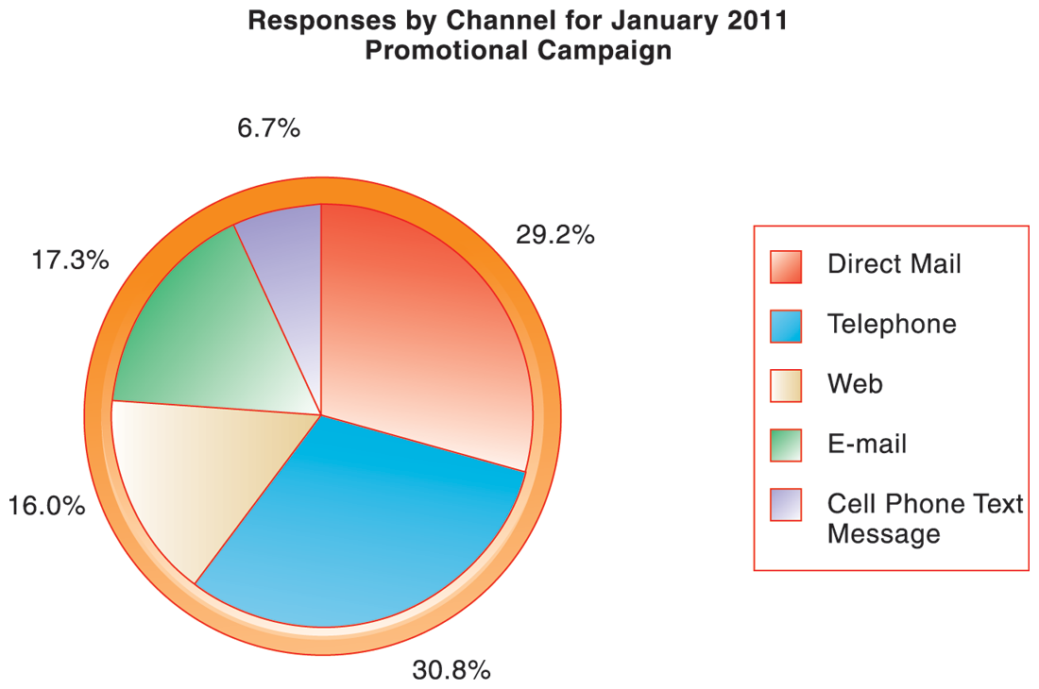
CHAPTER 9: ACHIEVING OPERATIONAL EXCELLENCE AND
CUSTOMER INTIMACY: ENTERPRISE APPLICATIONS
Customer Relationship Management Systems
HOW CRM SYSTEMS SUPPORT MARKETING
Customer relationship management software provides a single point for users to manage and evaluate marketing campaigns across multiple channels, including e-mail, direct mail, telephone, the Web, and wireless messages.
FIGURE 9-7
© Prentice Hall 2011
Notes:
This graphic gives an example of how CRM systems can support marketing by analyzing and evaluating marketing campaigns.

Slide 23
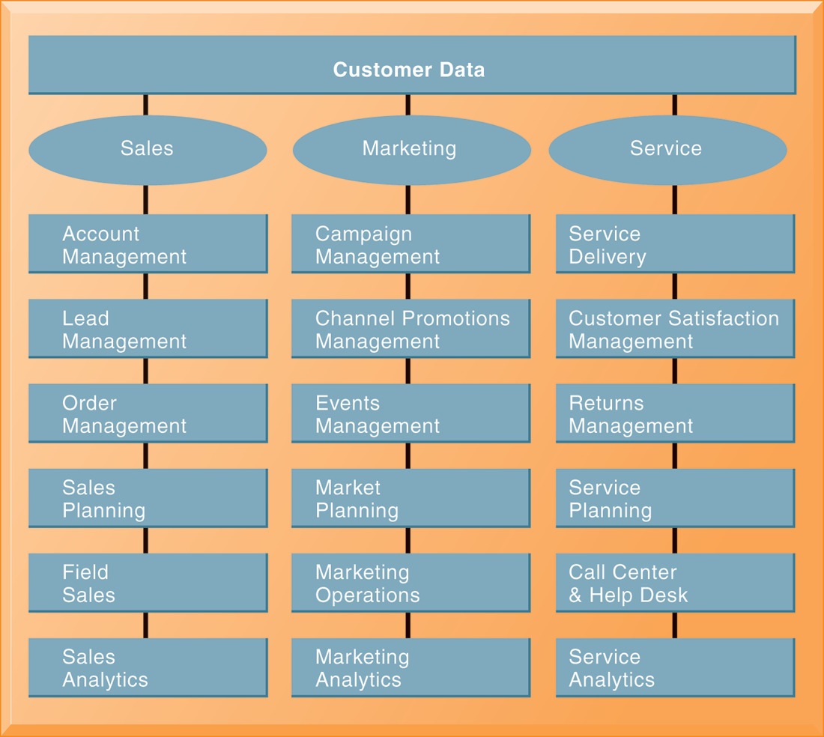
CHAPTER 9: ACHIEVING OPERATIONAL EXCELLENCE AND
CUSTOMER INTIMACY: ENTERPRISE APPLICATIONS
Customer Relationship Management Systems
CRM SOFTWARE CAPABILITIES
The major CRM software products support business processes in sales, service, and marketing, integrating customer information from many different sources. Included are support for both the operational and analytical aspects of CRM.
FIGURE 9-8
© Prentice Hall 2011
Notes:
This graphic illustrates the range of functions included in the sales, marketing, and service modules in a CRM package. As noted in the text, CRM software is business-process driven, incorporating hundreds of business processes thought to represent best practices in each of these areas. To achieve maximum benefit, companies need to revise and model their business processes to conform to the best-practice business processes in the CRM software.

Slide 24
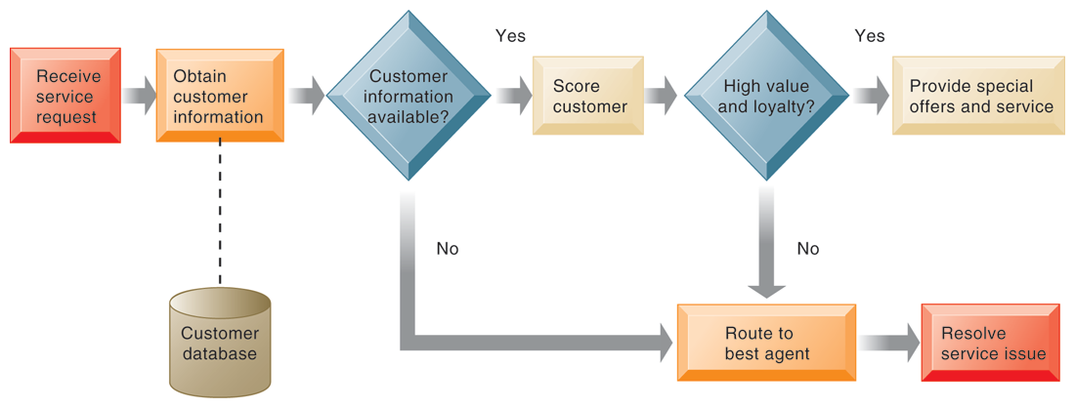
CHAPTER 9: ACHIEVING OPERATIONAL EXCELLENCE AND
CUSTOMER INTIMACY: ENTERPRISE APPLICATIONS
Customer Relationship Management Systems
CUSTOMER LOYALTY MANAGEMENT PROCESS MAP
FIGURE 9-9
This process map shows how a best practice for promoting customer loyalty through customer service would be modeled by customer relationship management software. The CRM software helps firms identify high-value customers for preferential treatment.
© Prentice Hall 2011
Notes:
This graphic illustrates how a best practice for increasing customer loyalty through customer service might be modeled by CRM software. What kinds of information might indicate that a customer is loyal or high value?

Slide 25
CHAPTER 9: ACHIEVING OPERATIONAL EXCELLENCE AND
CUSTOMER INTIMACY: ENTERPRISE APPLICATIONS
Customer Relationship Management Systems
Operational CRM:
  Customer-facing applications
    E.g. sales force automation, call center and customer service support, and marketing automation
Analytical CRM:
  Analyze customer data output from operational CRM applications
  Based on data warehouses populated by operational CRM systems and customer touch points
    Customer lifetime value (CLTV)
© Prentice Hall 2011
Notes:
This slide discusses the two main types of CRM software – operational and analytical. Ask students how the CLTV is calculated (it is based on the relationship between the revenue produced by a specific customer, the expenses incurred in acquiring and servicing that customer, and the expected life of the relationship between the customer and the company.)

Slide 26
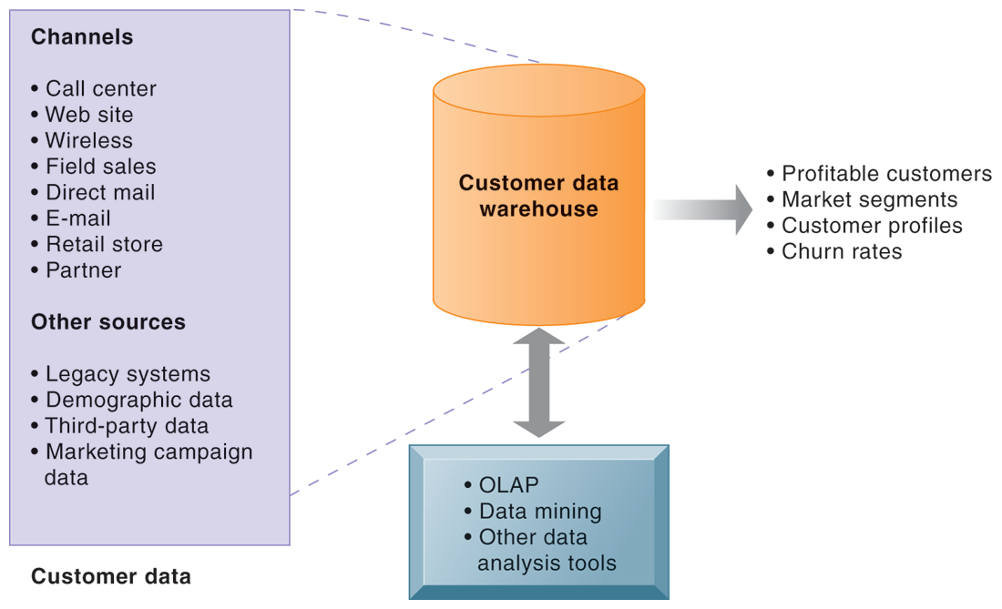
CHAPTER 9: ACHIEVING OPERATIONAL EXCELLENCE AND
CUSTOMER INTIMACY: ENTERPRISE APPLICATIONS
Customer Relationship Management Systems
ANALYTICAL CRM DATA WAREHOUSE
FIGURE 9-10
Analytical CRM uses a customer data warehouse and tools to analyze customer data collected from the firm’s customer touch points and from other sources.
© Prentice Hall 2011
Notes:
This graphic illustrates the main components of analytical CRM. Data is captured from various channels and fed into a customer data warehouse, where OLAP, data mining, and other analysis tools help identify profitable customers, churn rates, etc.

Slide 27
CHAPTER 9: ACHIEVING OPERATIONAL EXCELLENCE AND
CUSTOMER INTIMACY: ENTERPRISE APPLICATIONS
Customer Relationship Management Systems
Business value of CRM
  Increased customer satisfaction
  Reduced direct-marketing costs
  More effective marketing
  Lower costs for customer acquisition/retention
  Increased sales revenue
  Reduce churn rate
    Number of customers who stop using or purchasing products or services from a company.
    Indicator of growth or decline of firm’s customer base
© Prentice Hall 2011
Notes:
This slide discusses the value to businesses of implementing a CRM system. How would marketing be made more effective by using a CRM system?

Slide 28
CHAPTER 9: ACHIEVING OPERATIONAL EXCELLENCE AND
CUSTOMER INTIMACY: ENTERPRISE APPLICATIONS
Enterprise Applications: New Opportunities and Challenges
Technological changes
Business process changes
Organizational changes
Switching costs, dependence on software vendors
Data standardization, management, cleansing
© Prentice Hall 2011
Notes:
This slide looks at the challenges firms face when they implement enterprise applications. Ask students to explain and apply with examples of the concept of “switching costs.” What problems could result from being dependent on a single software vendor? Enterprise software vendors are addressing these problems by offering pared-down versions of their software and “fast-start” programs for small and medium-sized businesses and best-practice guidelines for larger companies.

Slide 29
CHAPTER 9: ACHIEVING OPERATIONAL EXCELLENCE AND
CUSTOMER INTIMACY: ENTERPRISE APPLICATIONS
Enterprise Applications: New Opportunities and Challenges
Next-generation enterprise applications
  Move is to make applications more flexible, Web-enabled, integrated with other systems
  Enterprise suites
    Software to enable CRM, SCM, and enterprise systems work together and with suppliers and client systems
    Utilize Web services, SOA
  Open source & on-demand solutions
  Mobile compatible; Web 2.0 capabilities
  Complementary analytics products
© Prentice Hall 2011
Notes:
This slide looks at the trends in enterprise software. The text cites the example of enterprise solutions from SAP, which combines key applications in finance, logistics and procurement, and human resources administration into a core ERP component. Businesses then extend these applications by linking to function-specific Web services such as employee recruiting or collections management provided by SAP and other vendors. SAP provides over 500 Web services through its Web site. Ask students to define open-source, and on-demand.

Slide 30
CHAPTER 9: ACHIEVING OPERATIONAL EXCELLENCE AND
CUSTOMER INTIMACY: ENTERPRISE APPLICATIONS
Enterprise Applications: New Opportunities and Challenges
ENTERPRISE APPLICATIONS MOVE TO THE CLOUD
What types of companies are most likely to adopt cloud-based ERP and CRM software services? Why? What companies might not be well-suited for this type of software?
What are the advantages and disadvantages of using cloud-based enterprise applications?
What management, organization, and technology issues should be addressed in deciding whether to use a conventional ERP or CRM system versus a cloud-based version?
© Prentice Hall 2011
Notes:
This slide presents discussion questions regarding the chapter case on enterprise applications delivered over “the cloud.” Until recently, Salesforce.com was one of the few successful, enterprise-scale SaaS. Today a growing number of cloud-based ERP and CRM providers are entering the marketplace, including RightNow (a CRM service used by Nikon) and the open-source Compiere Cloud Edition. Other major cloud vendors include IBM, Oracle, and HP.

Slide 31
CHAPTER 9: ACHIEVING OPERATIONAL EXCELLENCE AND
CUSTOMER INTIMACY: ENTERPRISE APPLICATIONS
Enterprise Applications: New Opportunities and Challenges
Service platform:
  Integrates multiple applications to deliver a seamless experience for all parties
    E.g. Order-to-cash process
  Portal software
    Used to integrate information from enterprise applications and legacy systems and present it as if coming from a single source
© Prentice Hall 2011
Notes:
This slide continues the discussion of trends in enterprise applications. Ask students what is a “service platform” and what are its benefits?

Slide 32
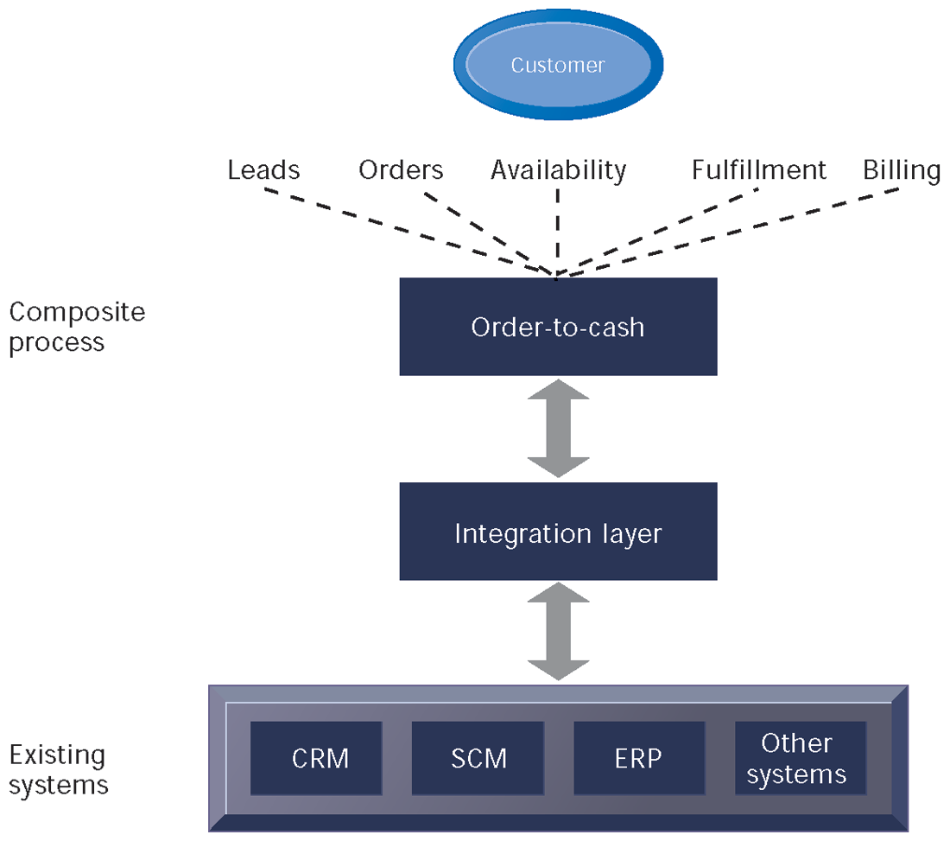
CHAPTER 9: ACHIEVING OPERATIONAL EXCELLENCE AND
CUSTOMER INTIMACY: ENTERPRISE APPLICATIONS
Enterprise Applications: New Opportunities and Challenges
ORDER-TO-CASH SERVICE
Order-to-cash is a composite process that integrates data from individual enterprise systems and legacy financial applications. The process must be modeled and translated into a software system using application integration tools.
FIGURE 9-11
© Prentice Hall 2011
Notes:
This graphic illustrates the structure of the order-to-cash service platform, which integrates data and processes from existing systems. Ask students to describe the order-to-cash process. The order-to-cash process involves receiving an order and seeing it all the way through obtaining payment for the order. This process begins with lead generation, marketing campaigns, and order entry, which are typically supported by CRM systems. Once the order is received, manufacturing is scheduled and parts availability is verified—processes that are usually supported by enterprise software. The order then is handled by processes for distribution planning, warehousing, order fulfillment, and shipping, which are usually supported by supply chain management systems. Finally, the order is billed to the customer, which is handled by either enterprise financial applications or accounts receivable. If the purchase at some point required customer service, customer relationship management systems would again be invoked.

Slide 33
CHAPTER 9: ACHIEVING OPERATIONAL EXCELLENCE AND
CUSTOMER INTIMACY: ENTERPRISE APPLICATIONS
© Prentice Hall 2011

